Slide 1
INFORMATION TECHNOLOGY
CLARK COLLEGE
SUPPORT SERVICES
Pandemic response

Slide 2
WINTER TERM B.A.U.
BUSINESS AS USUAL
ON CAMPUS COURSE OFFERING
Majority of courses were being taught in the classroom. No urgent plans or infrastructure in place for massive online services
SOME ONLINE CLASSES AVAILABLE
Few online classes available for students. Pilot online program underway. Online programs group established.
STEADY ONLINE GROWTH
Enrollment numbers trending term-to-term with more students taking online courses

Slide 3
LEVERAGING SURVEY TECHNOLOGY
UNDERSTANDING THE NEED
**EXTENT OF PANDEMIC UNKNOWN (Winter)
Without knowing the extent of the pandemic or the needs of the community a series of surveys were sent out to capture critical information to assist in determining technology needs. NOTE: IT Services still recovering from ctcLink migration.
WINTER/SPRING SURVEYS
GENERAL STUDENT 01
FACULTY/STAFF 02
STUDENT ACTUALS 03
FACULTY/STAFF – HD 04
SUMMER INTAKE 05

Slide 4
COVID – 19
MOVE TO ASSESS FOR ALL ONLINE OPERATIONS
INFRASTRUCTURE
Infrastructure inventory and shift to business continuity planning/deployment
CANVAS & VIDEO
TRAINING & SUPPORT
Provide canvas shells for every class. Support video options (TEAMS, ZOOM, Canvas Panapto).
Publish External IT Web pages, partner with instruction E-Learning in providing quick reference guides and Canvas support.
IMT & RECOVERY TEAMS
Stay connected with participation in the IMT & Recovery teams to ensure real time needs are met.

Slide 5
TECHNOLOGY EXPANDED
SHIFTING IT SERVICE MODEL
EXPAND WIRELESS and IT SERVICES
SERVICE: Upgrade wireless access points to expand services to all parking lots on campus. Open computer labs for faculty and students extend to remote model
PROVIDE STUDENT/STAFF OPTIONS
COMMUNICATION: Provide 3rd party connections to free and discounted services in prep for fully online term (Comcast, AT&T, Federal Aid)
SECURE LOANER TECHNOLOGY
PURCHASE: Secure all laptops on campus for reconfigure for home use. Purchase 500 student laptops, Hotspots, Cameras and Mics for distribution.
MOVE TO HYBRID/CLOUD SERVICES
INFRASTRUCTURE: Spin up survey for Faculty and virtual environments. Keep computer Labs open in Scarpelli Hall.
Notes:
SERVICE, COMMUNICATION, PURCHASING & ENHANCE INFRASTRUCTURE

Slide 6
REMOTE SERVICES
SHIFT ALL SERVICES TO REMOTE
Remote Desktop support
CLARK COLLEGE
USER NAME
CANVAS
TECH NEEDS
PASSWORD
SCHEDULE
Web site
REMOTE SUPPORT
LAPTOPS / CONFIGS
TOTAL MOBILE SUPPORT 03
Support faculty and staff with navigating technology options and access to college resources.
Reimage all laptops for remote use add quick reference guides and icons for ease of use.
Replicate logins for the student environment. Partner with Library on distribution leveraging scanning technology. Incredible amount of web development.

Slide 7
TECHNOLOGY SUPPORT
BY THE NUMBERS

Slide 8
COMPUTER TECHNOLOGY
THREE PHASE EVOLUTION
01 – STABILITY & BUSINESS CONTINUITY
We were not ready... Who was really!
- External surveys
- Internal assessments
**feeds
- Data informed decision making
02 – NEW WAYS OF WORKING
Institutionalize new ways of teaching, learning and working.
03 – LESSONS LEARNED & WHAT MOVES US FORWARD
How do we use best practice lessons from this crisis to create lasting technology changes… aaannnd then expand and enhance (continually).

Slide 9
IDEAL STATE
ACCESS ANYWHERE
LEVERAGING THE CLOUD and
Tools we already have
FLEXIBILITY
From all, frustrations with technology
ANALYTICS
Data informed and Governance.
COLLABORATION
Need support from all departments

Slide 10
AUTOMATING BUSINESS PROCESSES
COVID – 19 SCREENING
NAVIGATION
COVID - 19
Create self select health screening tools for Clark College Faculty, Staff, Students and Visitors
YES OR NO
Use Login Credentials
HEALTH SCREENING
Following Washington Department of Health Guidelines for return to campus operations

Slide 11
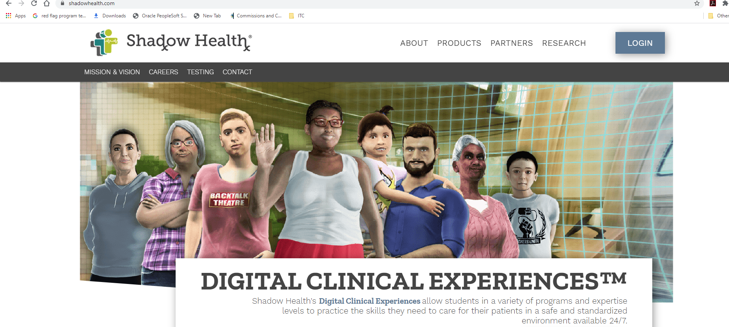

Slide 12
VIRTUAL REALITY… MAYBE
IS CLARK COLLEGE READY??
DIGITAL CLINICAL EXPERIENCES
NURSING program how do we expand studio use for all
VIRTURAL GRADUATION
EVENT SERVICES.
PHASE II HANDS ON CTC COURSE SUPPORT
CULINARY adjustments for accessibility (2019). ZOOM ROOM build out (2019)
LASTING TECHNOLOGY CHANGES
NEXT iteration of our learning environment (requires governance. Flexibility, Security, accessibility and IT talent).

Slide 13
Clark College
QUESTIONS?
Valerie Moreno, Chief Information Officer

Slide 14
TECHNOLOGY STACK
Network Architecture
IDENTITY, SECURITY & ACCESSIBILITY
PRODUCT
CONNECTIVITY
PRODUCT CLOUD
Smart product applications, Rules/analytic engine, application platform, product data database.
Smart product applications, Rules/analytic engine, application platform, product data database.
Smart product applications, Rules/analytic engine, application platform, product data database.
INTEGRATION
WITH BUSINESS
SYSTEMS – (Canvas)
EXTERNAL
INFORMATION
SOURCES – (ctcLink)
Notes:
Simplified Digital Ecosystem

Slide 15
TECHNOLOGY CONSIDERATIONS
THE WHAT AND THE HOW
LEVERAGING THE CLOUD
In support of hybrid environments for on campus and remote learning environments.
FLEXIBILITY
Critical this is new space for a good portion of our community
ANALYTICS
Leverage KPI’s and usage reports to be data informed
Governance and partnerships with instruction, SA, Bookstore, COVID Taskforce & in all areas of the College
COLLABORATION
ACCESS ANYWHERE
Open the door for anywhere access for ALL ensuring environment is secure and accessible

